Slide 1
Lesson objective
Title: Algebra descriptions
Aim:
Be able to write expressions from word descriptions
Plan:
Daily review
  Terminology
Writing from descriptions
Need Whiteboards

Slide 2
The word is
Pronumeral:
A letter or symbol used to represent a number.

Slide 3
The word is
Coefficient:
A number placed before a pronumeral.

Slide 4
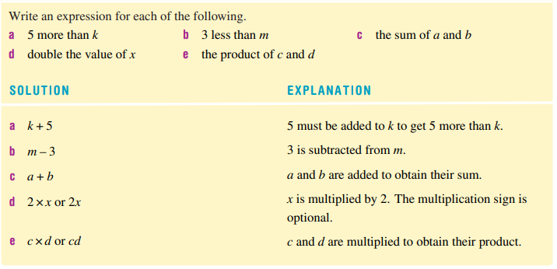

Slide 5
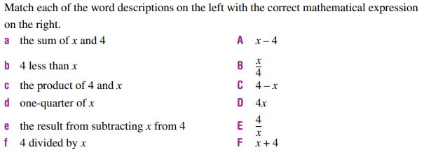

Slide 6
Whiteboards
Write a mathematical expression for:
7 is multiplied to f
the sum of 9 and g
t is subtracted from 12
8 is divided by h
F is multiplied to 20

Slide 7
Individual practice
Page 206
Questions 4 – 10

Slide 8
Reflection
Aim:
Be able to write expressions from word descriptions

